Slide 1

Data visualization with Python
Submitted By : Parneet Kaur Dhillon
( 72512933)
Shubhda Sharma
(72518599)

Slide 2
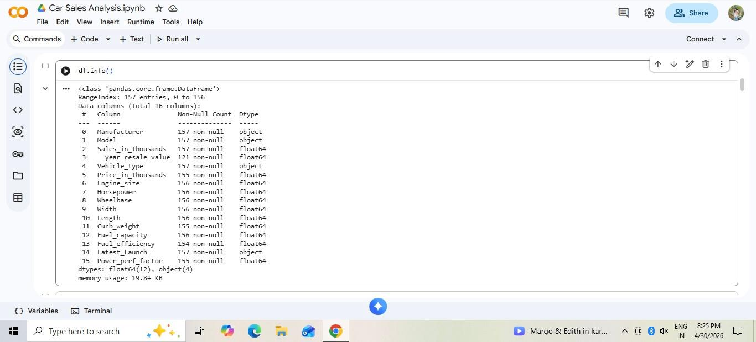
Data Description
It includes both categorical data (like Manufacturer, Model, Vehicle Type) and numerical data (like Sales, Price, Engine Size, Horsepower, etc.)
It consists of 157 Rows and 16 Columns
Notes:
Image source: https://www.shutterstock.com
3

Slide 3
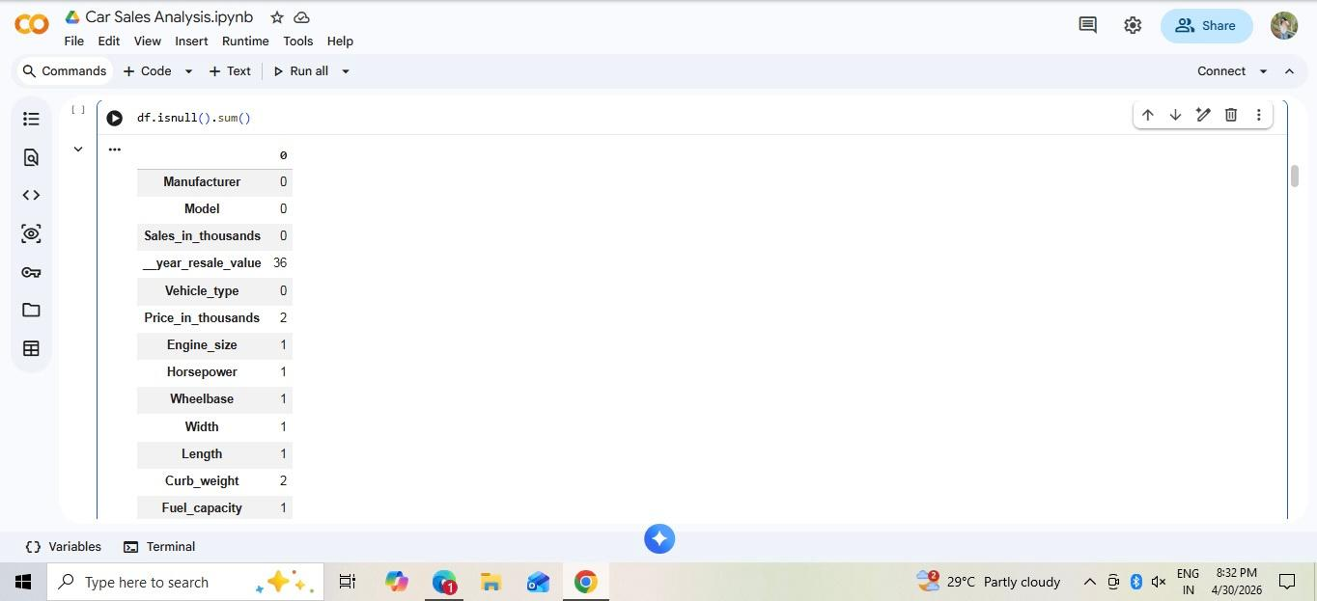
Null Values
Talking about the Null Values, we can clearly see that some dataset like ‘Resale Value’ , ‘Price’ , ‘ Engine size’ ,etc have null values
Notes:
Image source: https://thumbs.dreamstime.com
4

Slide 4
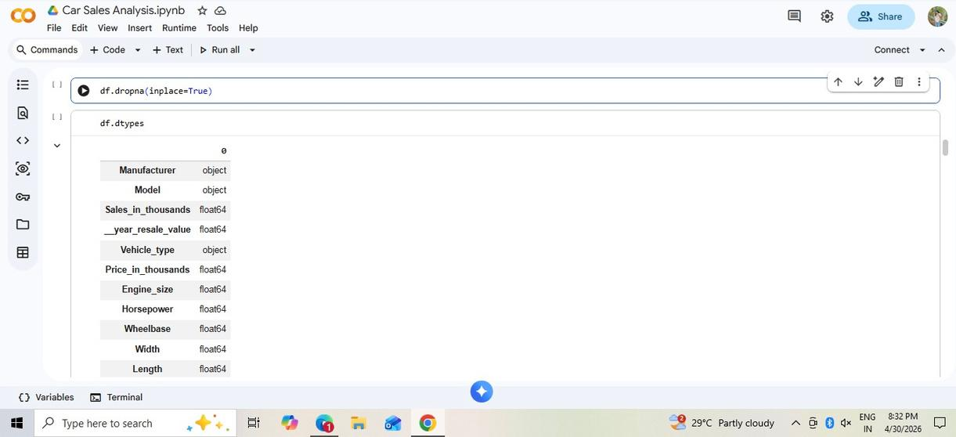
Treatment of Null Values
• In order to treat all the null values, we have to drop the null values using ‘Dropna’ , which removes all rows containing null values
• The parameter inplace=True ensures that changes are applied directly to the dataset
Notes:
Image source: https://thumbs.dreamstime.com
4

Slide 5
•This method helps in maintaining data accuracy and consistency
•After removing null values, the dataset becomes cleaner and more reliable for analysis and visualization
•Furthermore, the Datatype of the dataset is also provided
For example:- Manufacturer is Object
Sales is Float
Vehicle type is Object,etc
Notes:
Image source: https://history.computer.org
5

Slide 6
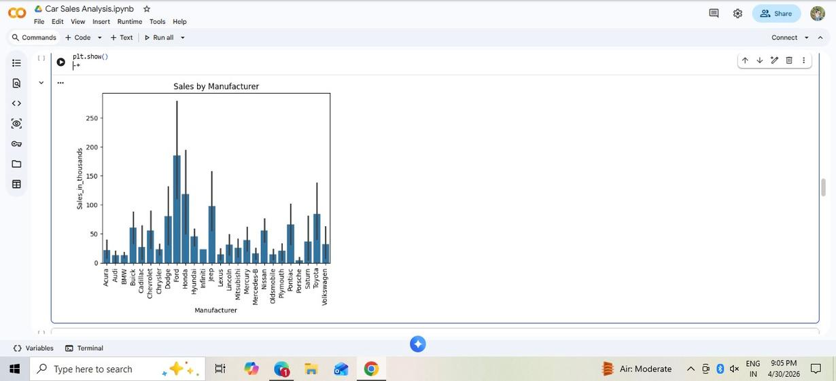
Data insights
•The bar plot compares car sales (in thousands) across different manufacturers.
•Brands like Ford, Chevrolet, and Toyota show higher sales, indicating stronger market performance
Notes:
Image source: https://thumbs.dreamstime.com
4

Slide 7
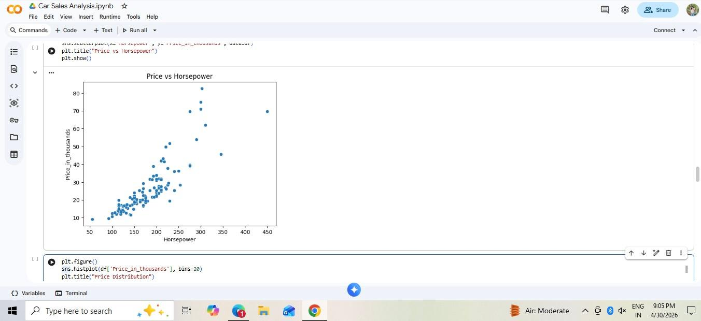
•The scatter plot shows the relationship between horsepower and car price
•There is a clear positive correlation—as horsepower increases, the price of cars also increases.
Notes:
Image source: https://thumbs.dreamstime.com
4

Slide 8
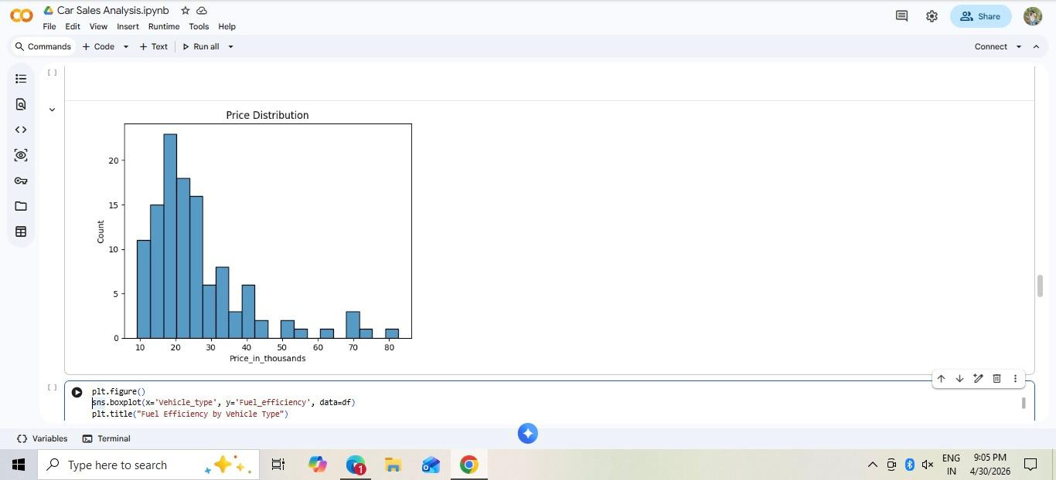
• The histogram shows the distribution of car prices in the dataset
•The dataset is dominated by mid-range cars, with only a few high-priced vehicles.
Notes:
Image source: https://thumbs.dreamstime.com
4

Slide 9
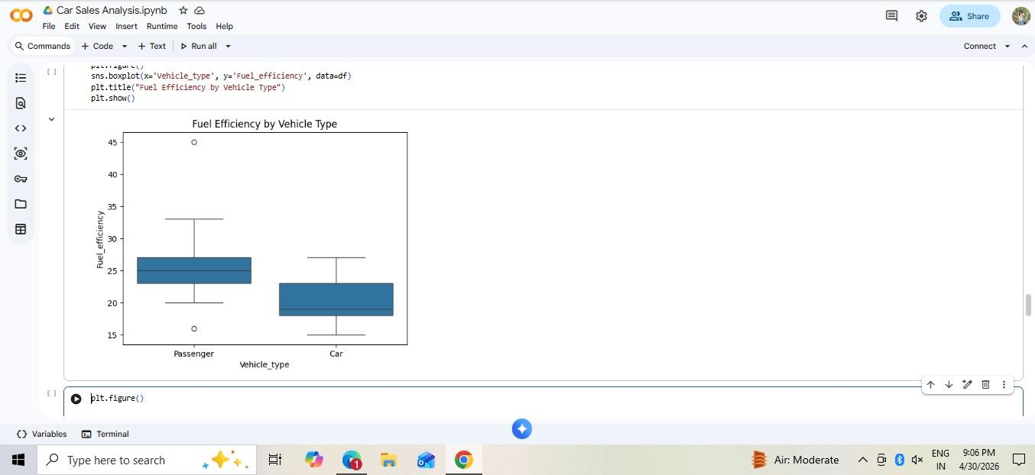
•The box plot compares fuel efficiency across different vehicle types
•Passenger-type vehicles tend to be more fuel-efficient compared to standard cars.
Notes:
Image source: https://thumbs.dreamstime.com
4

Slide 10
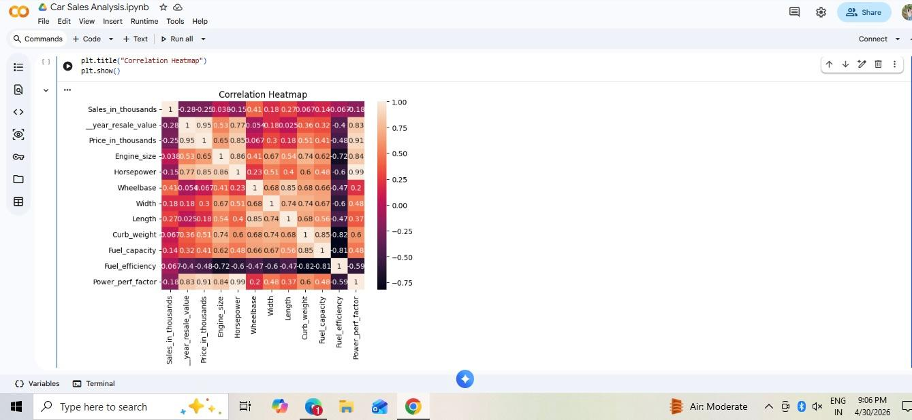
• This heatmap shows correlation between numerical variables in the dataset
•Sales show moderate relationships with some variables
Notes:
Image source: https://thumbs.dreamstime.com
4

Slide 11
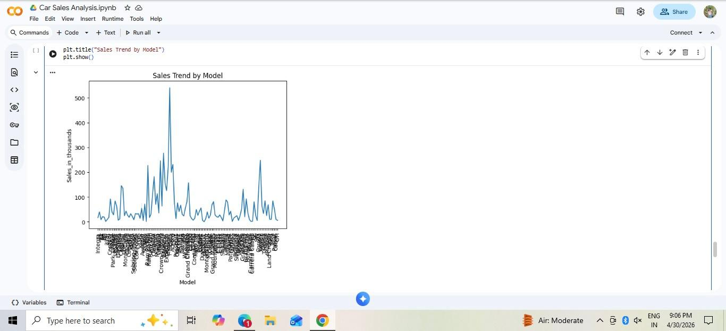
•The line chart shows sales variation across different car models.
•Car sales are unevenly distributed—only a few models achieve very high sales, while most perform moderately
Notes:
Image source: https://thumbs.dreamstime.com
4

Slide 12
Thank You

